Slide 1
Rota’s Lessons
（Rota的忠告）
2014組合數學新苗研討會
台灣師範大學數學系
2014年8月3日
李國偉
中央研究院數學研究所

Slide 2
Rota是什麼人？
是使組合數學成為當代重要數學領域的先驅

Slide 3
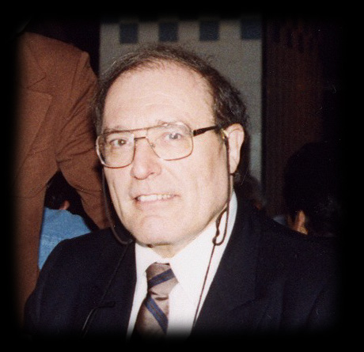
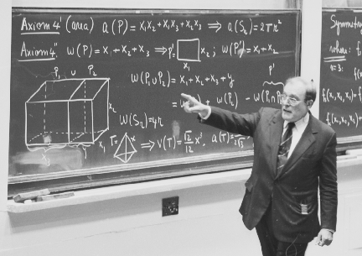
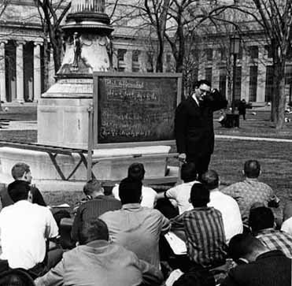
Gian-Carlo Rota, 1932-1999
Notes:
http://www.swotti.com/tmp/swotti/cacheZ2LHBI1JYXJSBYBYB3RHUGVVCGXLLVBLB3BSZQ==/imgGian-Carlo%20Rota3.jpg
http://faculty.uml.edu/dklain/rota.html
http://mstatic.mit.edu/nom150/items/rota.jpg

Slide 4
Gian-Carlo Rota出生在義大利，他的父親Giovanni是有名的反法西斯人士，曾列名於墨索里尼的追殺名單。
1945年全家先出走瑞士，再逃亡到南美厄瓜多爾。 1950年赴美普林斯頓大學讀書，1953年得BA summa cum laude。
1956從耶魯大學獲得博士學位，指導教授為Jacob T. Schwartz，論文題目為Extension theory of differential operators。

Slide 5
1959年Rota加入麻省理工學院。
1972年他成為該校唯一同時擁有應用數學與哲學教授頭銜的人。
1964年他發表論文On the Foundations of Combinatorial Theory。美國數學會在1988年頒發Steele獎給他時，稱讚這篇論文為
... the single paper most responsible for the revolution that incorporated combinatorics into the mainstream of modern mathematics.

Slide 6
ON THE FOUNDATIONS OF COMBINATORIAL THEORY
I. Theory of Möbius functions
II. Combinatorial geometries (with H. H. Crapo)
III. Theory of binomial enumeration (with R. Mullin)
IV. Finite vector spaces and eulerian generating functions (with J. Goldman)
V. Eulerian differential operators (by G. E. Andrews)
VI. The idea of generating function (with P. Doubilet, R. Stanley)
VII. Symmetric functions through theory of distribution and occupancy (with P. Doubilet)
VIII. Finite operator calculus (with D. Kahaner, A. Odlyzko)
IX. Combinatorial methods in invariant theory (with P. Doubilet, J. Stein)
X. A categorical setting for symmetric functions (with F. Bonetti, D. Senato, A. M. Venezia)

Slide 7
Gian-Carlo Rota was a mathematician and a philosopher, and the richness of his writing in these fields was known to both communities. I also like to think of him as a poet - not in the formal sense, since to the best of my knowledge he never wrote a poem - but in the larger sense of a person who expresses himself with imaginative power and beauty of thought.
E F Beschler, Notices Amer. Math. Soc. 47 (2) (2000)

Slide 8
Rota的忠告

Slide 10
Ten Lessons I wish I Had Been Taught
越排在後面的，越可能有爭議性

Slide 11
1. Lecturing a. Every lecture should make only one main point.
每場報告應該只有一個重點
An audience is like a herd of cows, moving slowly in the direction they are being driven towards.

Slide 12
1. Lecturing b. Never run overtime.
決不要超時
One minute overtime can destroy the best of lectures.

Slide 13
1. Lecturing c. Relate to your audience.
提一提聽眾的成果
Everyone in the audience has come to listen to your lecture with the secret hope of hearing their work mentioned.

Slide 14
1. Lecturing d. Give them something to take home.
總要給聽眾留下一些可回憶的東西
It is easier to state what features of a lecture the audience will always remember, and the answer is not pretty.

Slide 15
2. Blackboard Technique a. Make sure the blackboard is spotless.
開講前把黑板擦得乾乾淨淨
By starting with a spotless blackboard, you will subtly convey the impression that the lecture they are about to hear is equally spotless.

Slide 16
2. Blackboard Technique b. Start writing on the top left hand corner.
話講得慢一點，字寫得大一點
We all fall prey to the illusion that a listener will find the time to read the copy of the slides we hand them after the lecture. This is wishful thinking.

Slide 17
3. Publish the same result several times
Frederick Riesz’ Collected Papers所提供的啟示
The mathematical community is split into small groups, each one with its own customs, notation and terminology. It may soon be indispensable to present the same result in several versions, each one accessible to a specific group.

Slide 18
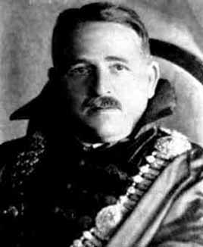
Frederick Riesz, 1880 - 1956
Notes:
http://www-history.mcs.st-andrews.ac.uk/Biographies/Riesz.html

Slide 19
4. You are more likely to be remembered by your expository work
原創論文難留名
Hilbert’s name is more often remembered for his work in number theory, his Zahlbericht, his book Foundations of Geometry and for his text on integral equations. . . . William Feller is remembered as the author of the most successful treatise on probability ever written.
Notes:
http://www.booktopia.com.au/david-hilbert-s-lectures-on-the-foundations-of-geometry-1891-1902-michael-hallett/prod9783540643739.html

Slide 20
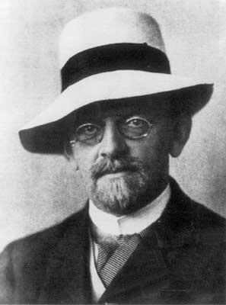
David Hilbert, 1862 - 1943
Notes:
http://en.wikipedia.org/wiki/David_hilbert

Slide 22
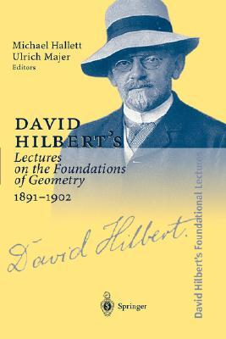

Slide 23
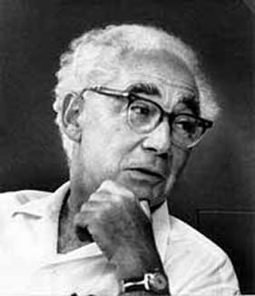
William Feller, 1906 - 1970
Notes:
http://www.croatianhistory.net/etf/feller1.jpg

Slide 24
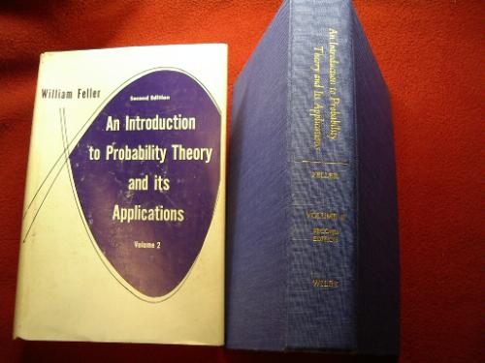

Slide 25
5. Every mathematician has only a few tricks
管用的招式有一兩招就很不錯了
But on reading the proofs of Hilbert’s striking and deep theorems in invariant theory, it was surprising to verify that Hilbert’s proofs relied on the same few tricks. Even Hilbert had only a few tricks!

Slide 26
6. Do not worry about your mistakes
就是大師也會出錯
There are two kinds of mistakes. There are fatal mistakes that destroy a theory; but there are also contingent ones, which are useful in testing the stability of a theory.

Slide 27
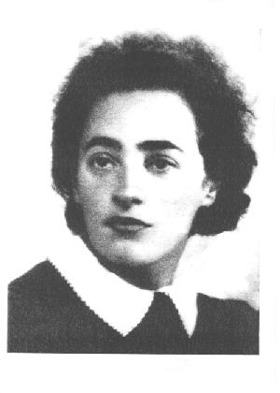
Olga Taussky, 1906 - 1995
Notes:
http://www.agnesscott.edu/lriddle/women/todd.jpg

Slide 28
7. Use the Feynman method
手上要有一些經常把玩的問題
You have to keep a dozen of your favorite problems constantly present in your mind . . . . Every time you hear or read a new trick or a new result, test it against each of your twelve problems to see whether it helps.

Slide 29
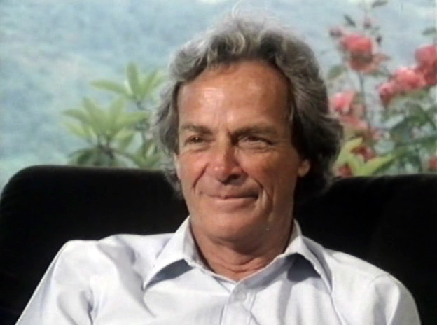
Richard Feynman, 1918 - 1988
Notes:
http://www.washington.edu/news/2011/10/05/much-more-than-physics-remembering-common-book-author-richard-feynman/

Slide 30
8. Give lavish acknowledgments
論文裡多提別人的貢獻
I have always felt miffed （不爽）after reading a paper in which I felt I was not being given proper credit, and it is safe to conjecture that the same happens to everyone else.

Slide 31
9. Write informative introductions
概述部分寫不好，誰還想看下文
Nowadays, reading a mathematics paper from top to bottom is a rare event. If we wish our paper to be read, we had better provide our prospective readers with strong motivation to do so.

Slide 32
10. Be prepared for old age
為老年做好心理準備
You become an institution, and you are treated the way institutions are treated. You are expected to behave like a piece of period furniture（17、8世紀的家具）, an architectural landmark, or an incunabulum（15世紀前的印刷書）.

Slide 33
Ten Lessons for the Survival of a Mathematics Department

Slide 34
1. Never wash your dirty linen in public
別在別的系裡講自己系上同事的壞話
Departments of a university are like sovereign states: there is no such thing as charity towards one another.

Slide 35
2. Never go above the head of your department
別越級打報告
Your letter will be viewed as evidence of disunity in the rank and file of mathematicians.
Human nature being what it is, such a dean or provost is likely to remember an unsolicited letter at budget time, and not very kindly at that.

Slide 36
3. Never compare fields
在外行人面前要讚美數學裡每個領域都很棒
And remember, when talking to outsiders, have nothing but praise for your colleagues in all fields, even for those in combinatorics. All public shows of disunity are ultimately harmful to the well-being of mathematics.

Slide 37
4. Remember that the grocery bill is a piece of mathematics too
別瞧不起別人使用的數學
At other times, a careless statement of relative values is more likely to turn potential friends of mathematics into enemies of our field. Believe me, we are going to need all the friends we can get.

Slide 38
5. Do not look down on good teachers
會教書的老師是系上的寶
When Mr. Smith dies and decides to leave his fortune to our mathematics department, it will be because he remembers his good teacher Dr. Jones who never made it beyond associate professor, not because of the wonderful research papers you have written.

Slide 39
6. Write expository papers
要會推銷數學的成果
It is not enough for you (or anyone) to have a good product to sell; you must package it right and advertise it properly. Otherwise you will go out of business.

Slide 40
7. Do not show your questioners to the door
即使他們的問題很簡單，也不要太快打發走
Listening to engineers and other scientists is our duty. You may even learn some interesting new mathematics while doing so.

Slide 41
8. View the mathematical community as a United Front（聯合陣線）
團結一切可以替數學出力的人
It is our best interest, as well as the interest of justice, to treat all who deal with mathematics in whatever way as equals. By being united we will increase the probability of our survival.

Slide 42
9. Attack flakiness
把科學從不可靠中解救出來
Mathematics can save the world from the invasion of the flakes by unmasking them and by contributing some hard thinking. . . . .
This is the biggest chance we have had in a long while to make a lasting contribution to the well-being of Science.

Slide 43
10. Learn when to withdraw
要善待數學文盲，否則人家會把我們幹掉
When you meet someone who does not know how to differentiate and integrate, be kind, gentle, understanding. Remember, there are lots of people like that out there, and if we are not careful, they will do away with us.

Slide 44
謝謝聆聽

